Slide 1

Project c cohort 9
NAME: Jean KENMOGNE
DATE: July 7, 2020

Slide 2
Certified Ethical Hacking: DVWA, Mutillidae and Various Tools
EXPLAIN VARIOUS WEB BASED EXPLOITS
DEMO EXPLOITS USING DVWA
DEMO VARIOUS TOOLS

Slide 3
Explain concepts on various web application attacks
PART 1

Slide 5
DEMO 4 EXPLOITS USING DVWA
PART 2

Slide 6
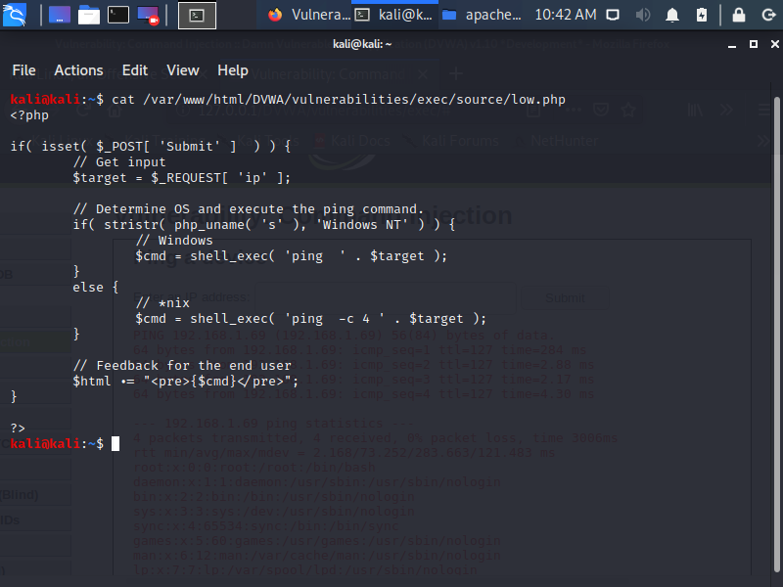
Command Injection Based Attacks (DVWA)
cat/var/www/html/dvwa/vulnerabilities/exec/source/low.php
1
After enter the ip address, there is NO RESPONSE.
Displaying the /etc/passwd file, there is NO RESPONSE
Display the weakness of ping typing the command: cat/var/www/html/dvwa/vulnerabilities/exec/source/low.php
We have 4 security level of DVWA

Slide 7
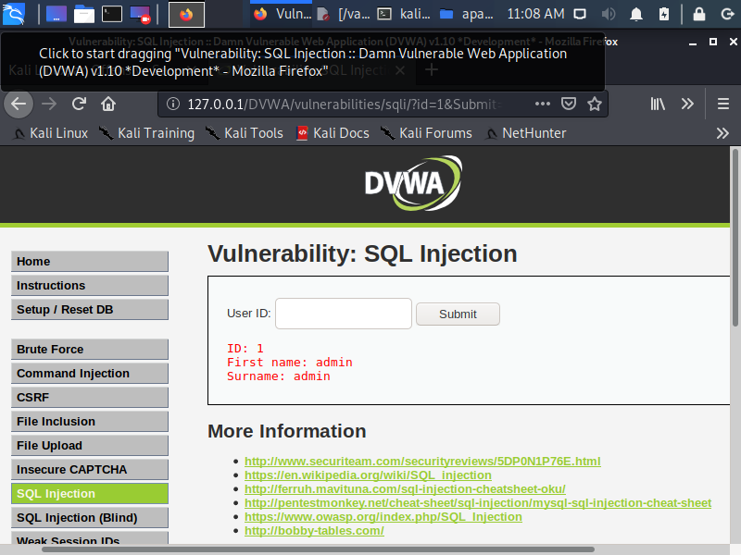
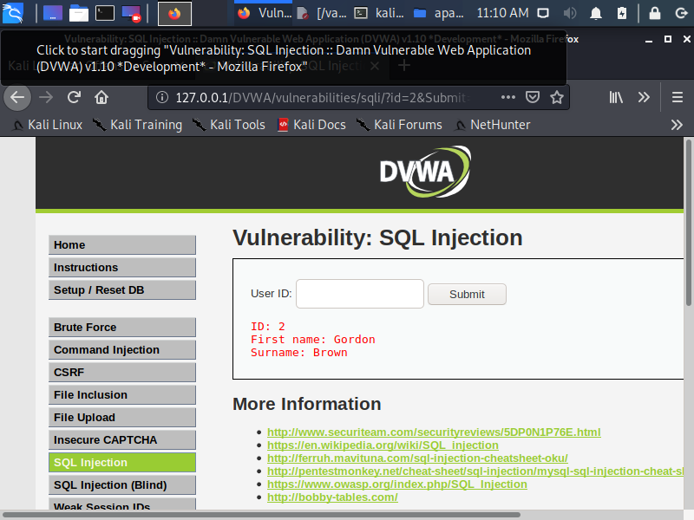
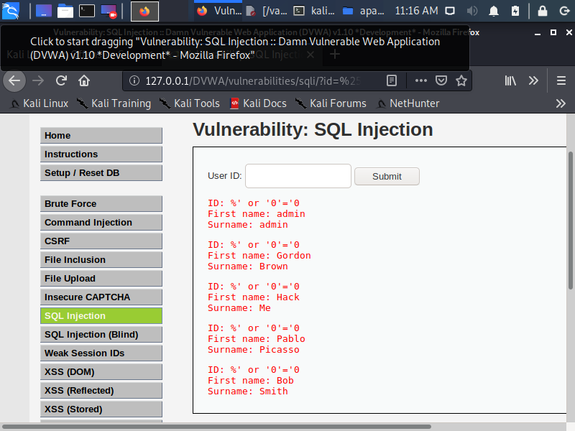
SQL INJECTION
ID 1
ID 2
2
Display ID 2 in the User ID Column
Display ID 1 in the User ID Column
Type %’ or 0=0 in the user ID column. The result is 5 IDs.
%’ or 0=0

Slide 8
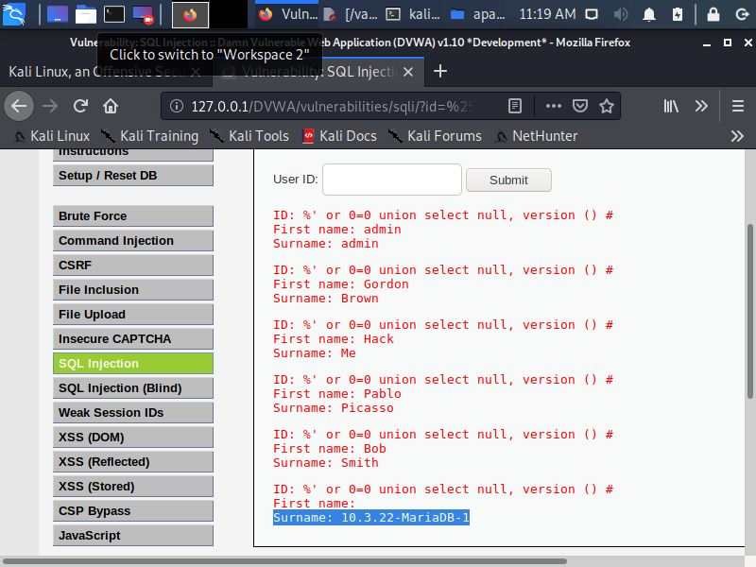
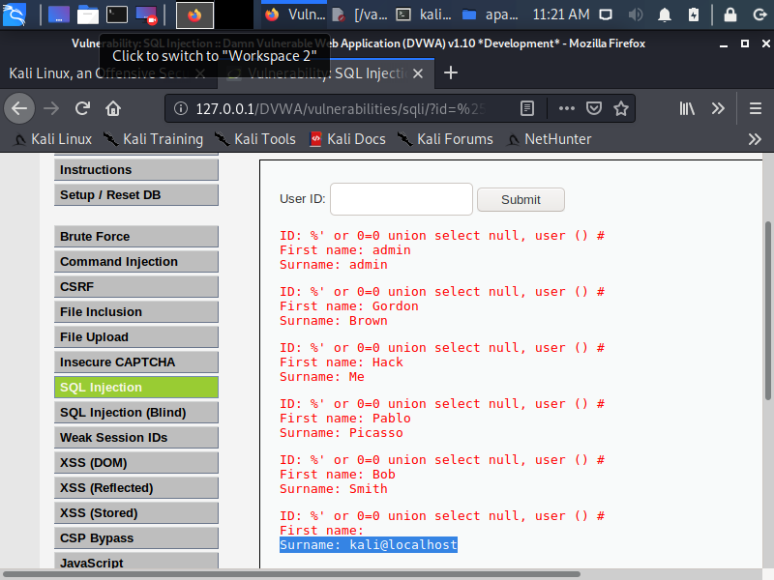
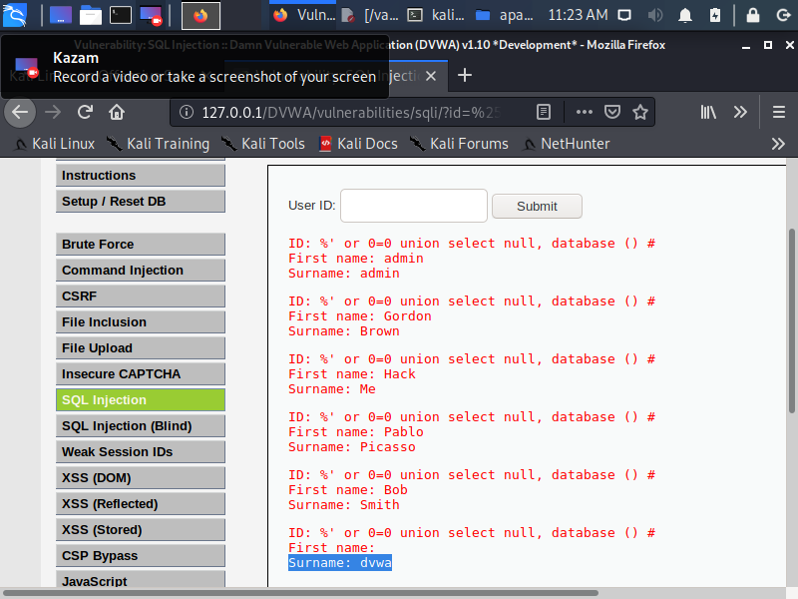
SQL INJECTION
%’ or 0=0 union select null, version()#
%’ or 0=0 union select null, user()#
2 (continued)
1 - Display the database version:
%’ or 0=0 union select null, version()#
2 - Display the database user:
%’ or 0=0 union select null, user()#
3 - Display the database name:
%’ or 0=0 union select null, database()#
SQL injection vulnerabilities can be catastrophic because they can allow an attacker to view , insert, delete or modify records in a database. In a SQL injection attack, the attacker inserts or injects partial or complete SQL queries via the web application. SQL commands are injected into input fields in an application or a URL in order to perform the execution of predefined SQL commands.
The SQL statement (command) SELECT is Used to obtain data from a database.
The SQL UNION operator is used to combine the result set of two or more SELECT statements. UNION operator selects only distinct values. UNION ALL can be use to allow duplicate values. UNION operator can be use in SQL injection attack to join a query. The main goal is to obtain the values of columns of other tables.
%’ or 0=0 union select null, database()#

Slide 9
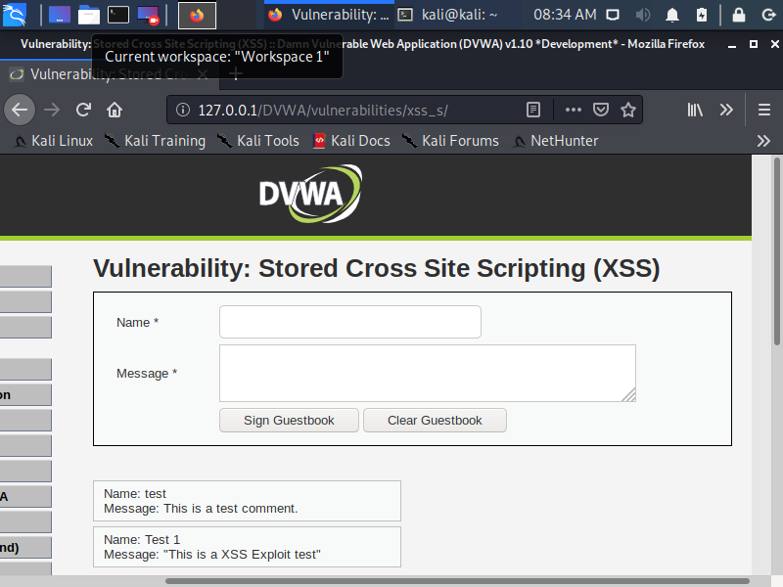
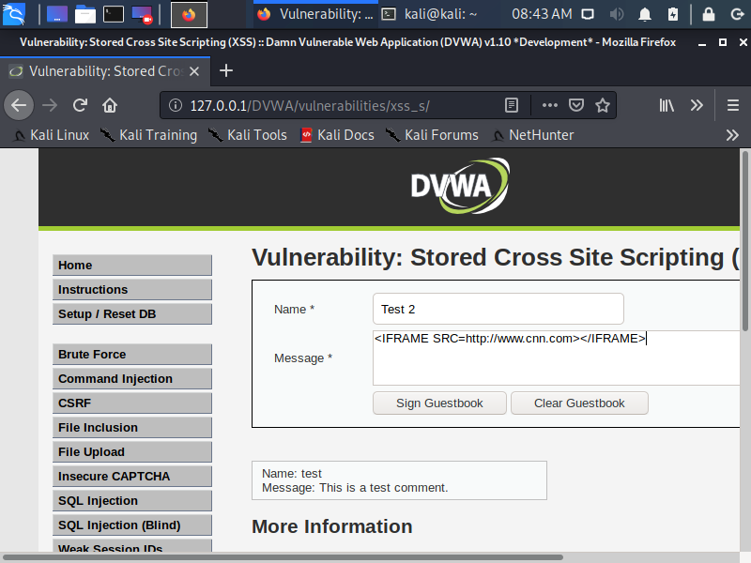
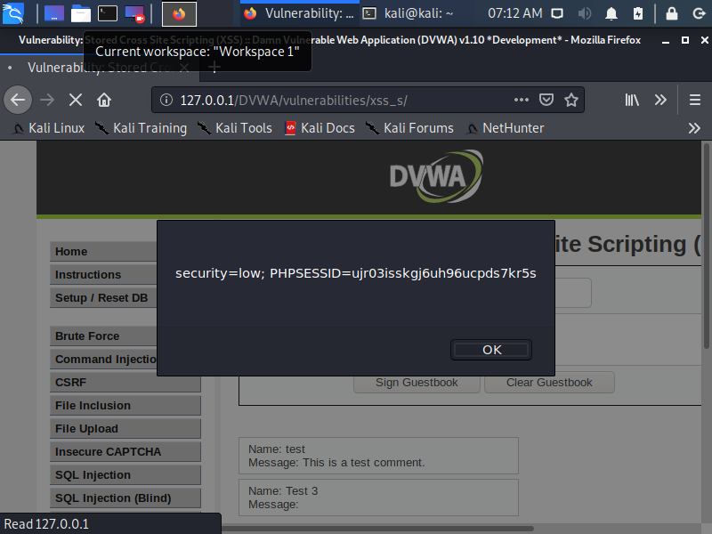
Cross-Site Scripting (XSS)
Test 1
Test 2
“This is a XSS Exploit test”
<iframe src=http://www.cnn.com></iframe>
3
Test 1
“This is a XSS Exploit test”
Test 2
<iframe src=http://www.cnn.com></iframe>
Test 3
<script>alert(document.cookie)</script>
{Stored XSS are referred to a persistent XSS attack. This occur when the malicious code or script is permanently stored on a vulnerable or malicious server using a database; typically found in websites hosting blog posts, web forums. An example is when a user request the stored information from the vulnerable or malicious server. Then the vulnerable sever is usually a known or trusted site.}
Test 3
<script>alert(document.cookie)</script>

Slide 10
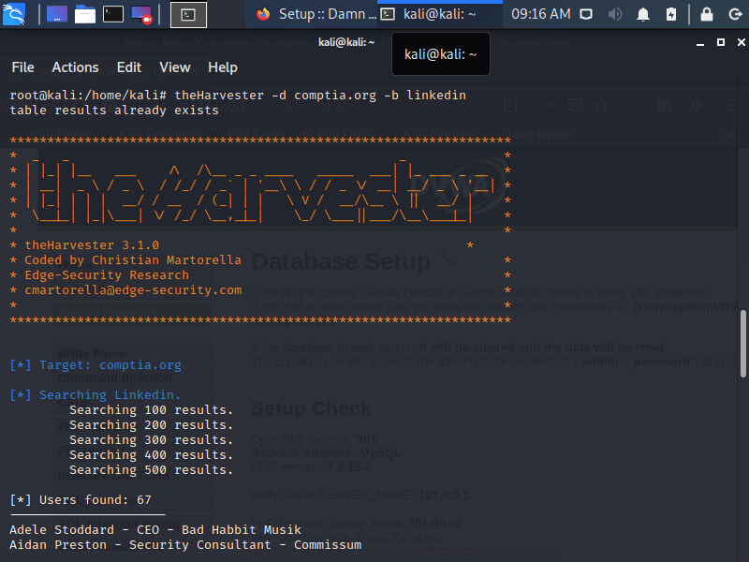
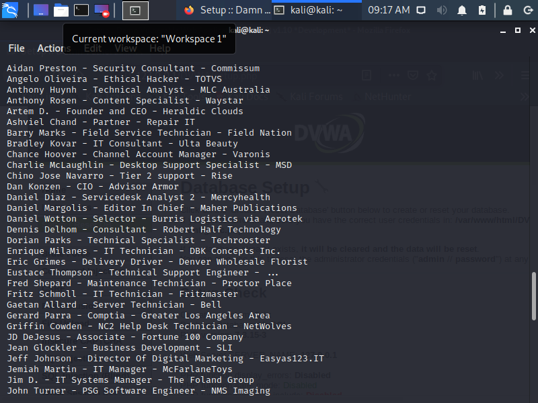
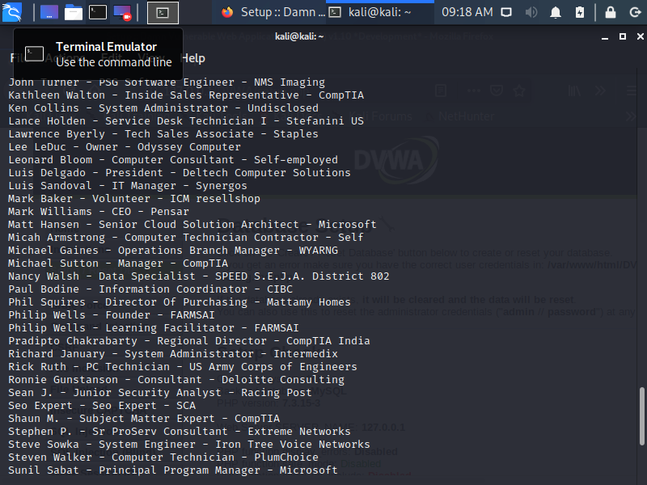
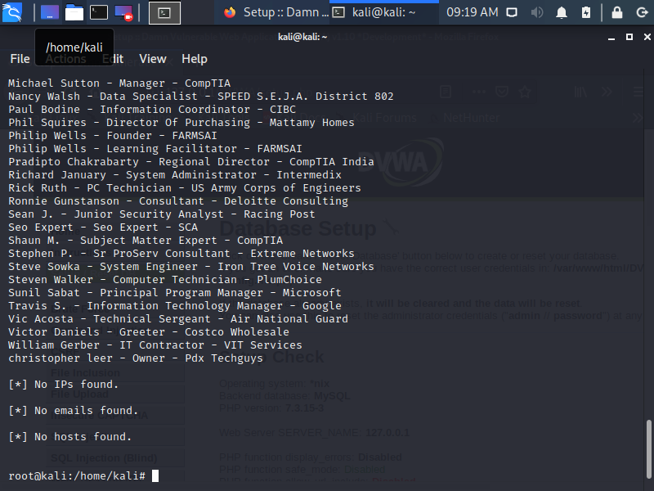
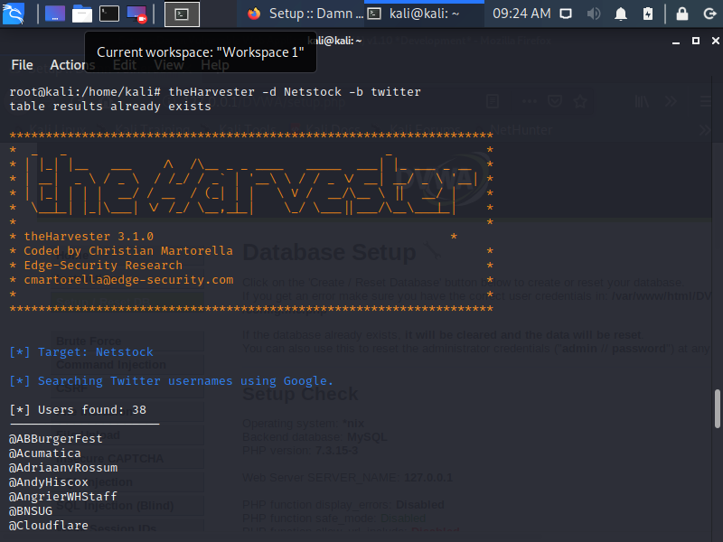
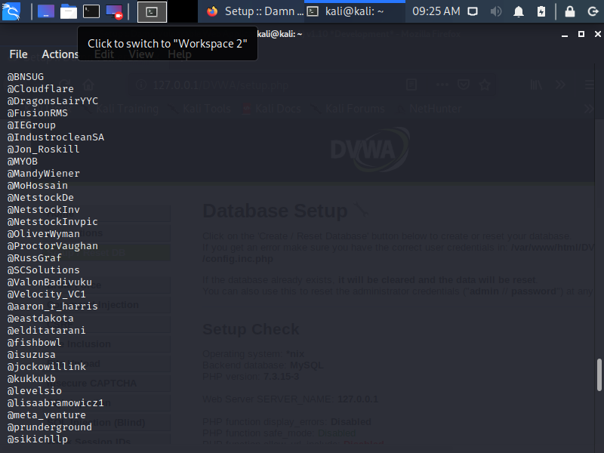
TheHarvester
1
4
theHarvester –d www.comptia.org –b LinkedIn
1 – Get the LinkedIn accounts for all users in Comptia.org
theHarvester –d www.comptia.org –b LinkedIn
2 – Get the Twitter accounts for all users in Netstock.co
theHarvester –d www.Netstock.co –b Twitter
“{ the Harvester’s basic command syntax: theharvester -d [domain] -l [number_of_results] -b [source_of_search_query].
The objective of this program is to gather emails, subdomains, hosts, employee names, open ports and banners from different public sources like search engines, PGP key servers and SHODAN computer database. This tool is intended to help Penetration testers in the early stages of the penetration test in order to understand the customer footprint on the Internet. It is also useful for anyone that wants to know what an attacker can see about their organization.} “
KALI Tools
2
theHarvester –d www.Netstock.co –b Twitter

Slide 11
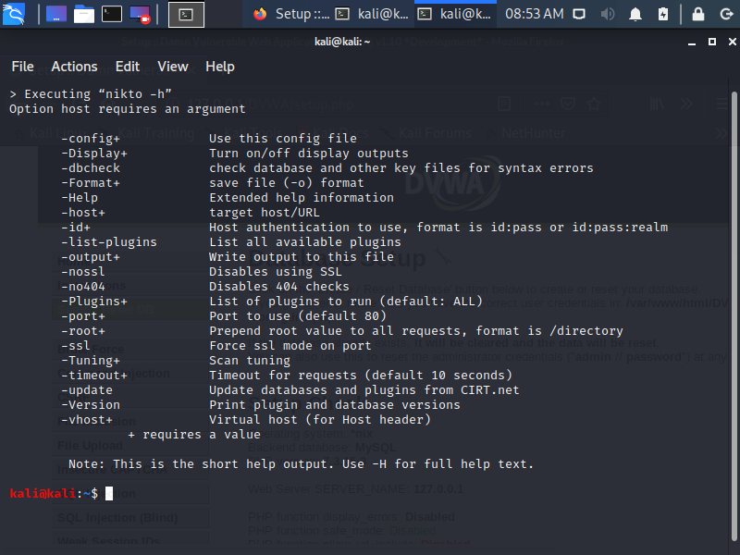
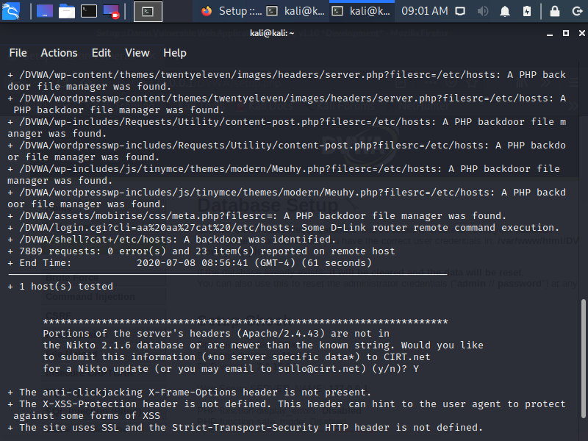
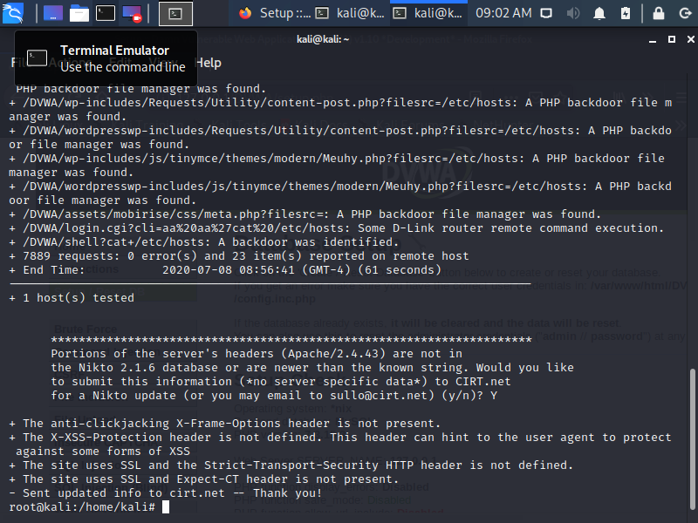
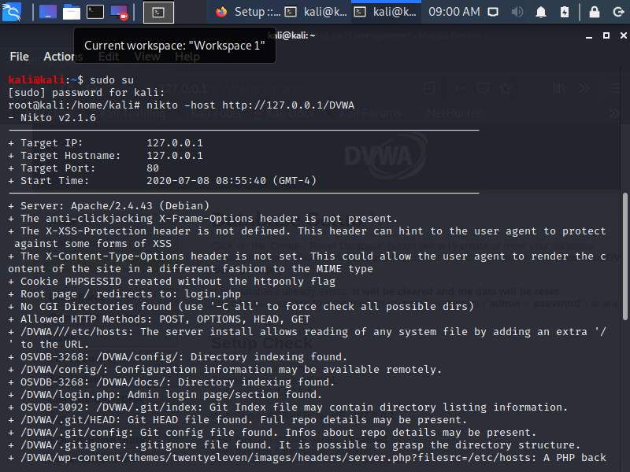
NIKTO
5
Nikto –h
1 – Perform a Nikto scan the DVWA web site (use http://) on the appropriate VM
Where is Nikto located : on the Kali main screen-option 2 Vulnerability Analysis
At the command line, type Sudo su to root
type Nikto help ( the output is 20 options on how to use with Nikto)
Scan DVWA: Type Nikto –host http://127.0.0.1/DVWA
We can see that the version of running Apache is identify as Apache/2.4.43 (Debian) and many vulnerabilities.
“{A simple, easy-t0-use Perl script web-vulnerability program that is fast and thorough. It even supports basic port scanning to determine whether a web server is running on any open ports.
Nikto is an Open Source (GPL) web server scanner which performs comprehensive tests against web servers for multiple items, including over 6700 potentially dangerous files/programs, checks for outdated versions of over 1250 servers, and version specific problems on over 270 servers. It also checks for server configuration items such as the presence of multiple index files, HTTP server options, and will attempt to identify installed web servers and software. Scan items and plugins are frequently updated and can be automatically updated.
Nikto is not designed as a stealthy tool. It will test a web server in the quickest time possible, and is obvious in log files or to an IPS/IDS. However, there is support for LibWhisker’s anti-IDS methods in case you want to give it a try (or test your IDS system).}”
KALI TOOLS
Nikto –host http://127.0.0.1/DVWA

